Slide 1
Using Random Sampling to Integrate Functions: Monte Carlo Integration
Math 32, Fall 2020
Discussion Section #7

Slide 2
Monte Carlo Integration
Using computers to generate random samples is a common tool for optimization, stochastic modeling, parameter estimation.
These are generally called Monte Carlo Methods.
Today, you will see a little bit of the magic of random sampling by using random sampling to calculate integrals.
Monte Carlo Integration

Slide 3
Simple Example: .
Method 1: Analytical Integration (by hand)
Method 2: Quadrature (numerical)
Method 3: MC -- random sampling the area enclosed by a<x<b and 0<y<max (p(x))
p(x)
P(x)
a
b
x
a
b
Notes:
One of the most important application of MC is Integration,
As we know, we can do integration for simple functions with Analytical method, we can also do it by quadrature method; that is we divided it into small intervals, then calculate each interval with Simpson rule, or gaussion method, find the area of each interval, then add them together.
A simple idea to do the integration with MC is like this:
First, we generate the random samples within the box a-b and 0-maxp(x), then for all the samples, we classify then to two categories: the green one and the red one, by testing if y<P(x). The integration of function P(x) could be approximate with this equation.

Slide 4
Simple Example: .
Intuitively:

Slide 5
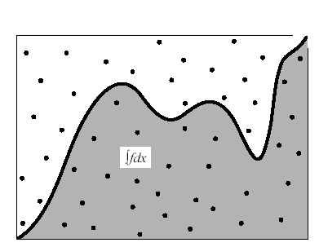
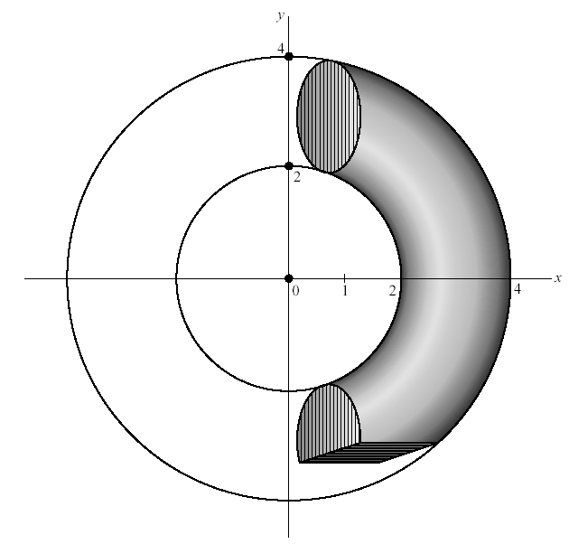
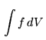
Monte-Carlo Integration
Integrate a function over a complicated domain
D: complicated domain.
D’: Simple domain, superset of D.
Pick random points over D’:
Counting: N: points over D
N’: points over D’
D’: rectangular
D
D’: circle
D

Slide 6
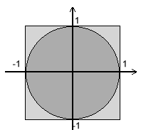
Estimating π using Monte Carlo
The probability of a random point lying inside the unit circle:
If pick a random point N times and M of those times the point lies inside the unit circle:
If N becomes very large,
(x,y)
M
N

Slide 7
Estimating π using Monte Carlo
N = 10² π ≈ 3.28
N = 10³ π ≈ 3.072
N = 10⁴ π ≈ 3.126
N = 10⁵ π ≈ 3.14928
N = 10²
N = 10³
N = 10⁴
N = 10⁵

Slide 8
How Can we Do This for Ourselves in R?

Slide 9
What does our R Code do?
Example code monteCarloIntegral1D.R
Calculates the Integral in 3 Ways:
By Hand (Calculus)
Numerical Integration (R)
Monte Carlo Integration

Slide 10
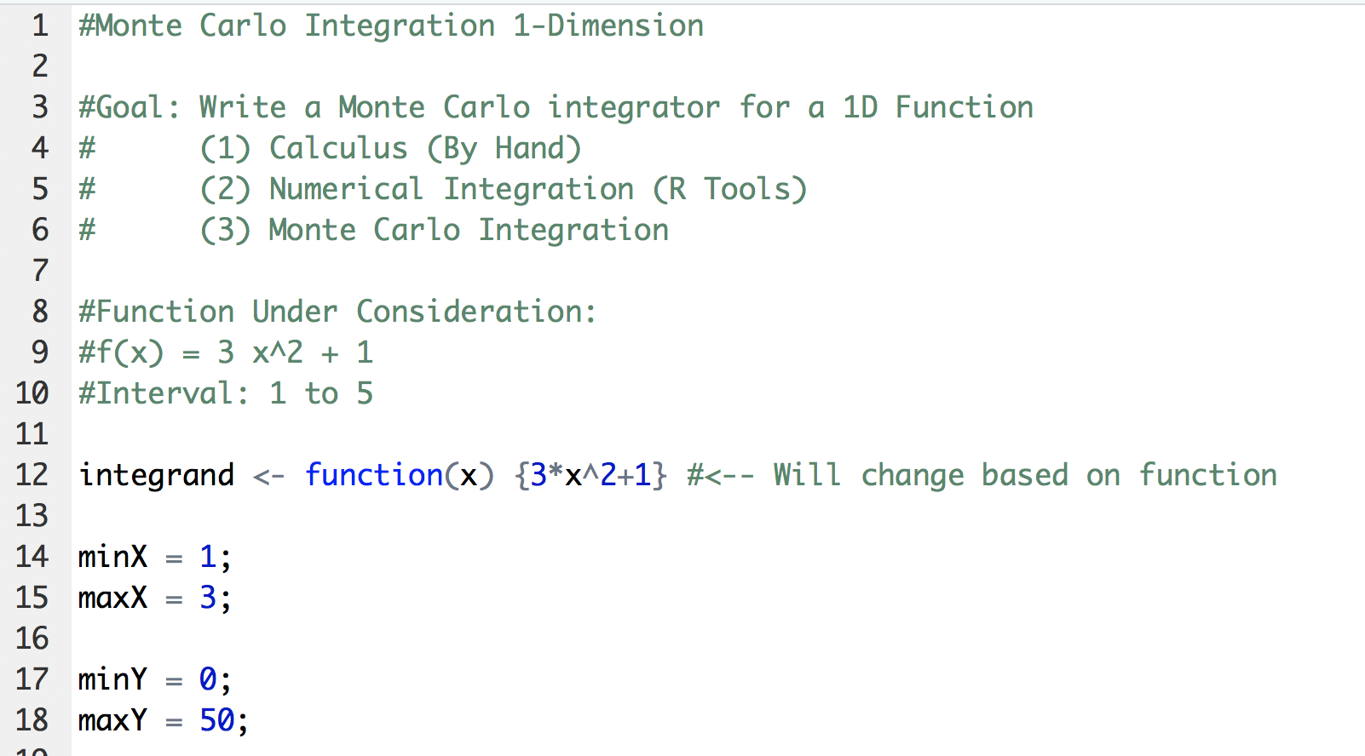
R Code

Slide 11
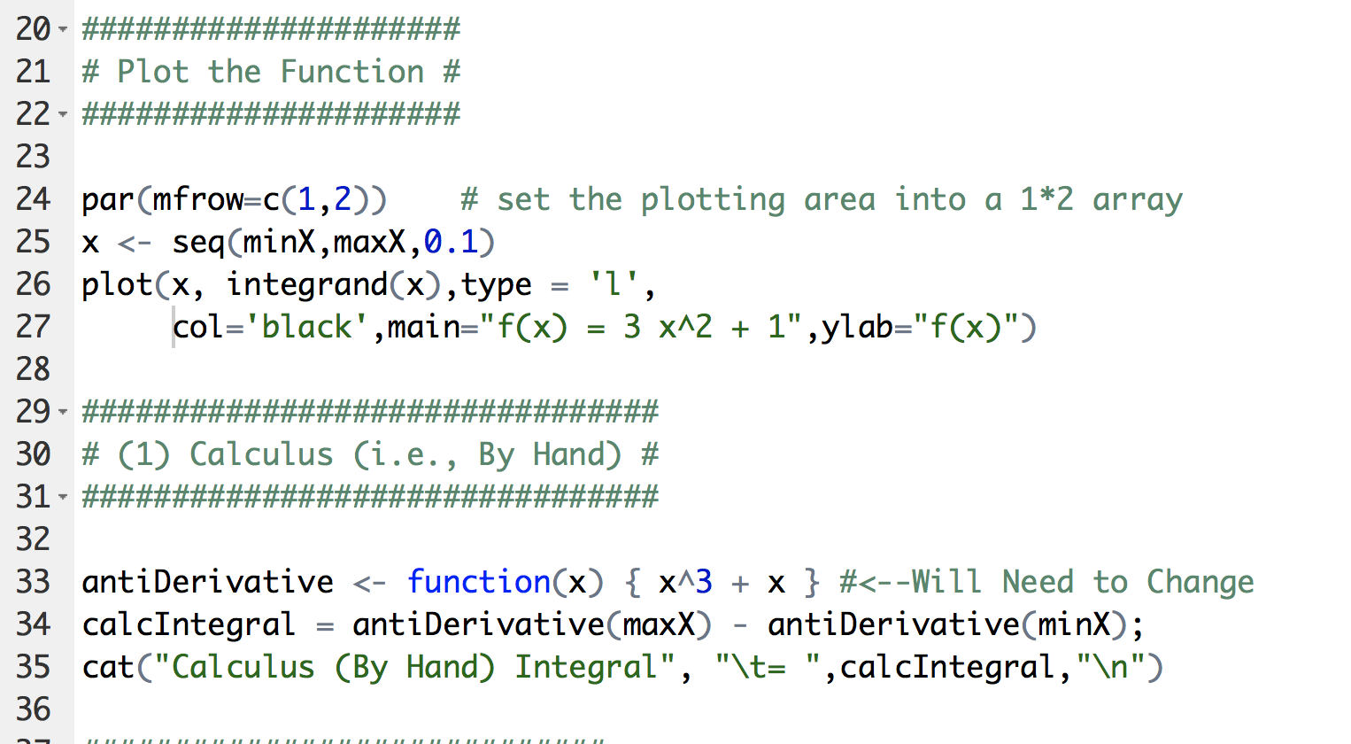
R Code

Slide 12
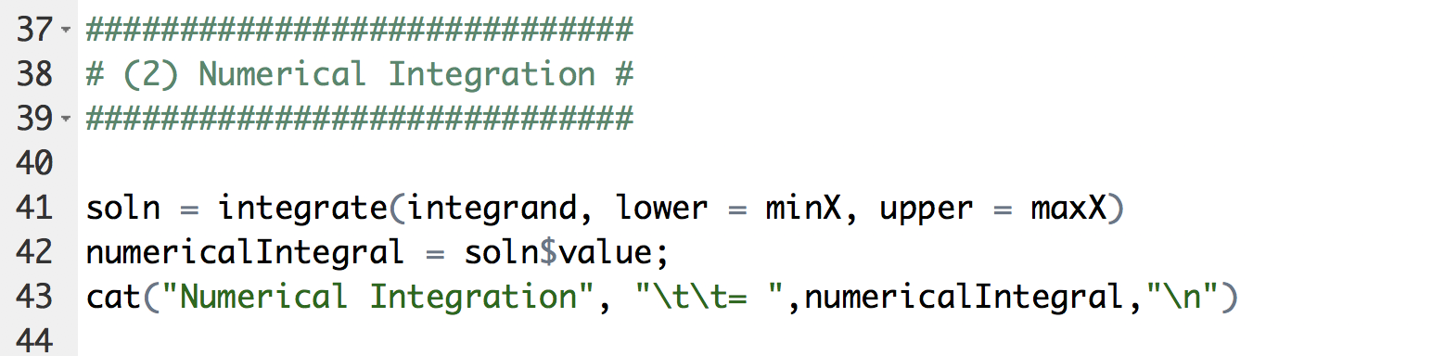
R Code

Slide 13
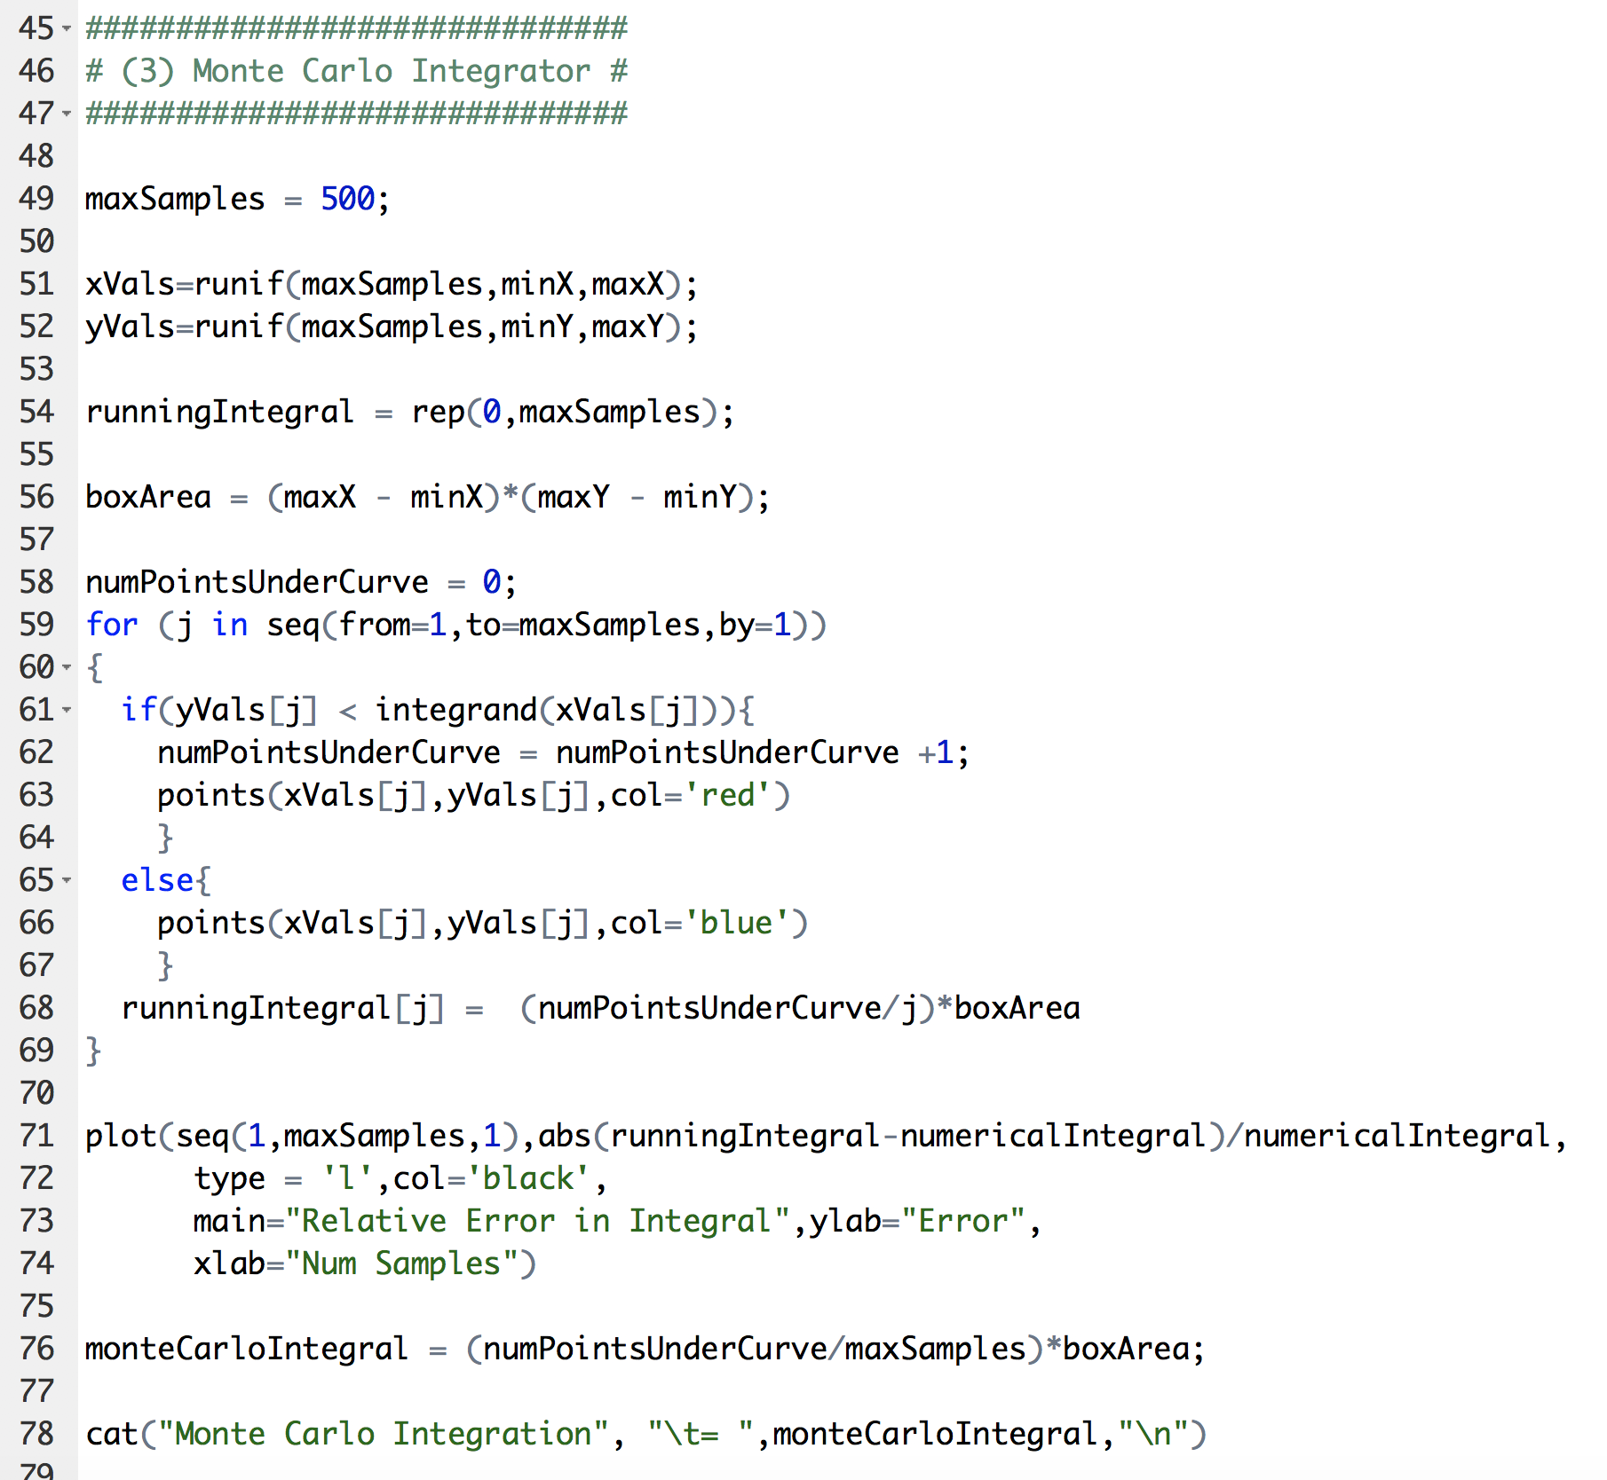
R Code
Generate this many samples
Sample X and Y uniformly in box.
Are you under the curve?
YES!

Slide 14
Plot Output

Slide 15
Higher Dimensional Sampling

Slide 16
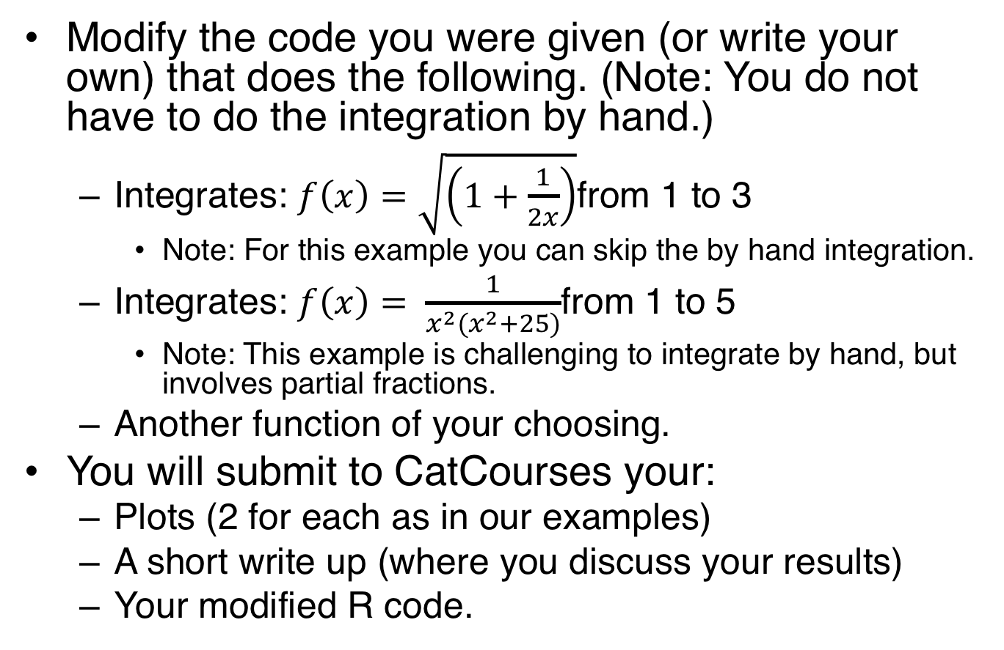
Lab 07
Modify the code you were given (or write your own) that does the following. (Note: You do not have to do the integration by hand.)
Integrates: $f\left(x\right)=\sqrt{\left(1+\frac{1}{2x}\right)}$from 1 to 3
Note: For this example you can skip the by hand integration.
Integrates: $f\left(x\right)= \frac{1}{x^{2}(x^{2}+25)}$from 1 to 5
Note: This example is challenging to integrate by hand, but involves partial fractions.
Another function of your choosing.
You will submit to CatCourses your:
Plots (2 for each as in our examples)
A short write up (where you discuss your results)
Your modified R code.

